Slide 1

2023 CEO Report
Reflections: My 13 Years as CEO
Karen A. Goraleski
CEO, ASTMH
October 21, 2023
Annual Business Meeting
Chicago, Illinois, USA

Slide 2

First Things First
ASTMH Team:
Stephen Croll
Lyn Maddox
Shaima Abdul-Aziz
Annie Calacci
Judy DeAcetis
Doug Dusik
Buffy Finn
Thank you!
Rebecca Hamel
Brenda Howe
Alison Jaeb
Rhonda Schultz
Chelsea Taylor

Slide 3
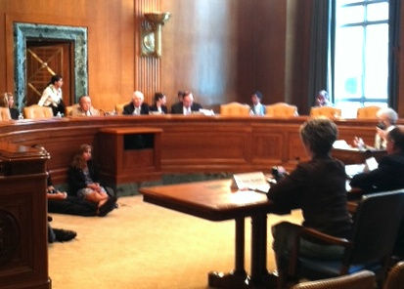
ASTMH Testifies Before Senate Defense Appropriations Subcomittee
June 22, 2011
Testimony before Chairman Inouye
(D-HI) and Ranking Member Cochran (R-MS) in support of expanded funding for the military’s investment in tropical medicine R&D
ASTMH the only global health scientific society to testify

Slide 4
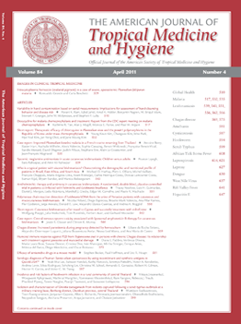
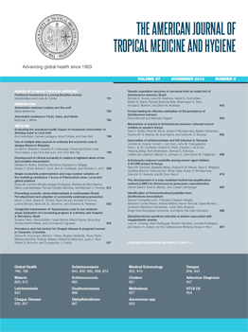

AJTMH
2002 -2012
1988-2001

Slide 5

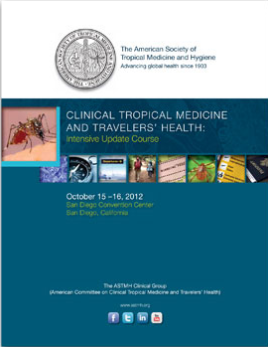



Slide 6

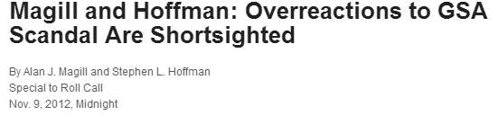
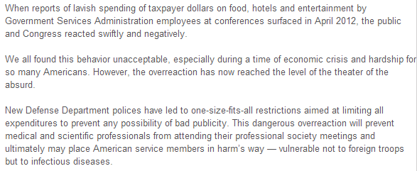
ROLL CALL’S REACH
11,500 copies hand-delivered daily to House and Senate*
*when Congress in session

Slide 7

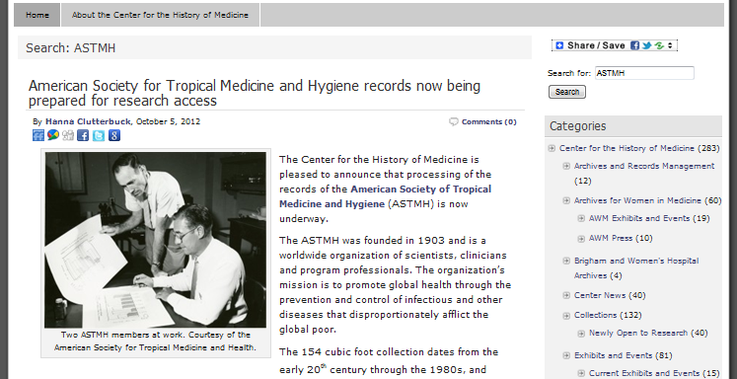

Slide 8

3rd Annual ASTMH in Peru, Feb. 13, 2013
“This ASTMH-Peru collaboration is a uniquely grassroots effort and the brainchild of our Peruvian colleagues [who] organize and fund the meeting completely… an exemplary model that showcases the impressive science conducted by our international members.” ~Alan Magill, MD, FASTMH
350+ attendees
more than doubled
since first year
Society represented at event by President-elect Alan Magill and Councilor Dan Bausch, MD, MPH

Slide 9


Hill Briefing - Oct 24, 2013
“Conquering Cholera in Haiti and the Dominican Republic: The Untold Story of Progress”
135 attendees, 47 Hill staff

Slide 10

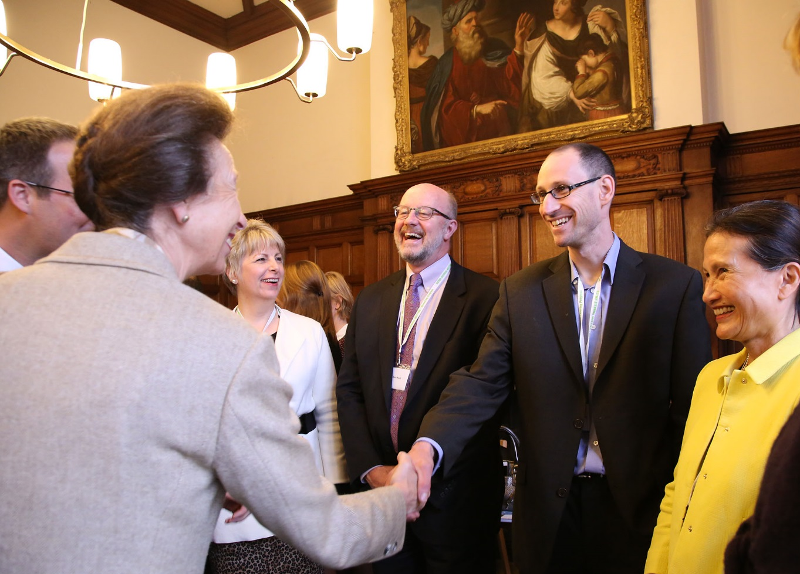

Royal Society of Tropical Medicine and Hygiene Biennial Meeting
Oxford Town Hall -- September 2014
Keynote Address: Alan Magill
“Mind the Gap: Complete Detection, Complete Cure and Complete Transmission Prevention to Accelerate Malaria Eradication”
Notes:
Note to KG: Mackay medal, Simon Hay, Gerrie McHugh

Slide 11

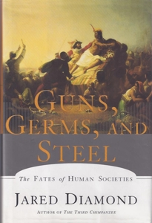







Council Picks:
Summer Books and Flicks
Notes:
Done – nice!

Slide 12
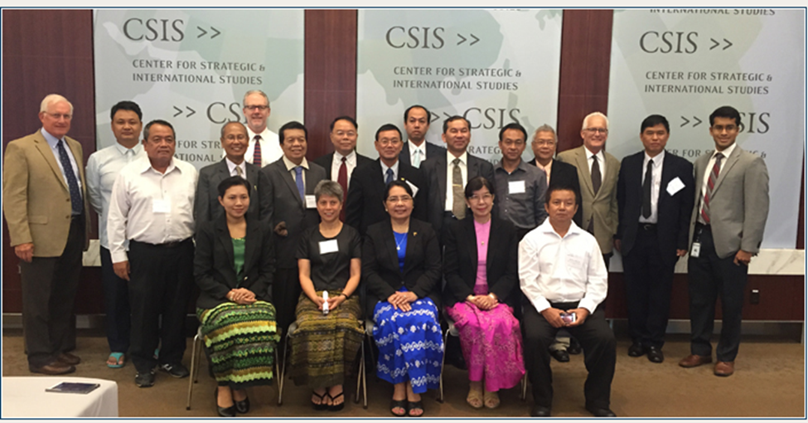
Working Together to Eliminate Malaria in Myanmar -- Aug 2-4, 2015
ASTMH
University of Maryland School of Medicine Institute for Global Health
Science Diplomacy

Slide 13





Slide 14


Slide 15
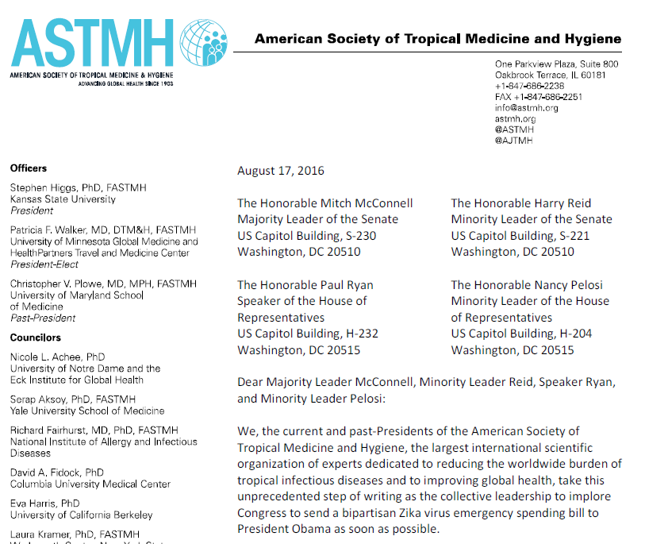
Unprecedented Action by 26 ASTMH Presidents
“Patchwork and inadequate funding will not do the job –plain and simple.”
“…stop this endless cycle of fire alarms at every outbreak.”
“We have the ability to affect the trajectory of [Zika]… to not do so is imprudent and reckless.’”

Slide 16
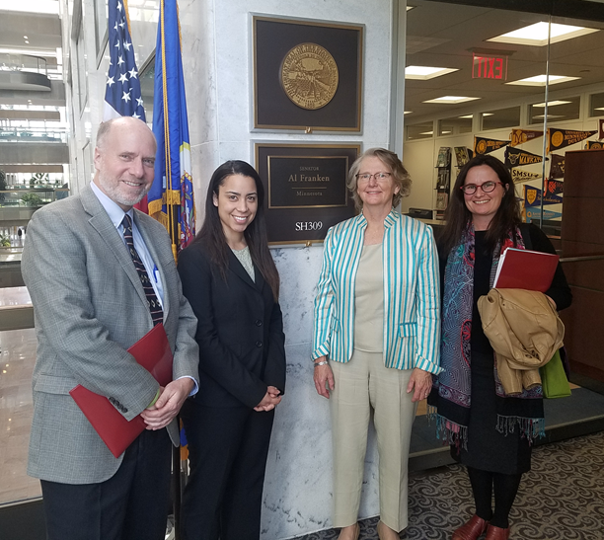
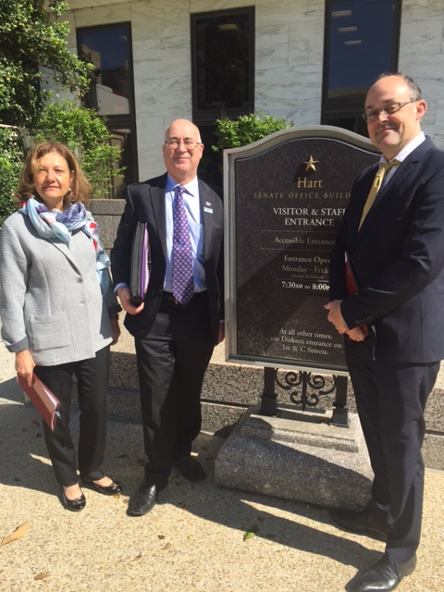
ASTMH Leadership on The Hill May 16, 2016
22 Hill Meetings
  15 Senate/7 House
  15 Democrats/7 Republicans
Attendees:
  Serap Aksoy
  Lyric Bartholomay
  Dan Bausch
  Rick Fairhurst
  David Fidock
  Kathryn Hanley
  Steve Higgs
  Duane Hospenthal
  Phil Rosenthal
  Pat Walker

Slide 17
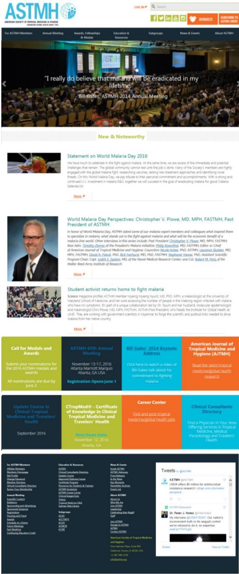
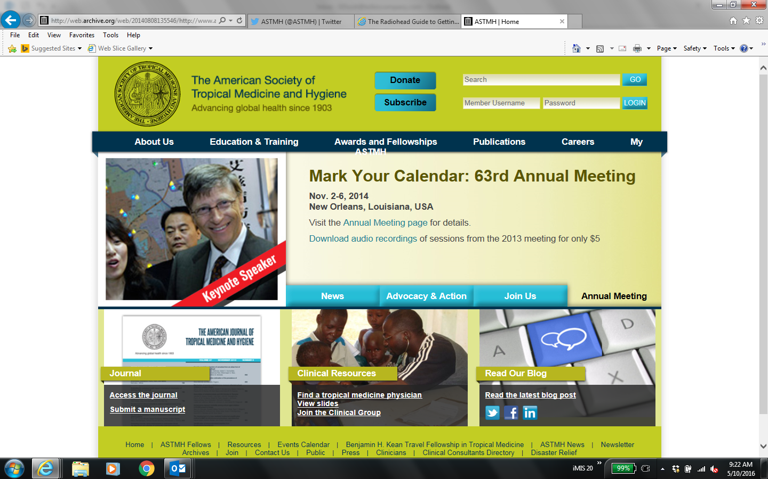
Goodbye Old Website
Welcome Refreshed, Updated Website
Input from 50 member volunteers
Better functionality, easier navigation, added features
New Pages
  Key Moments
  Celebrating
  Alan Magill

Slide 18
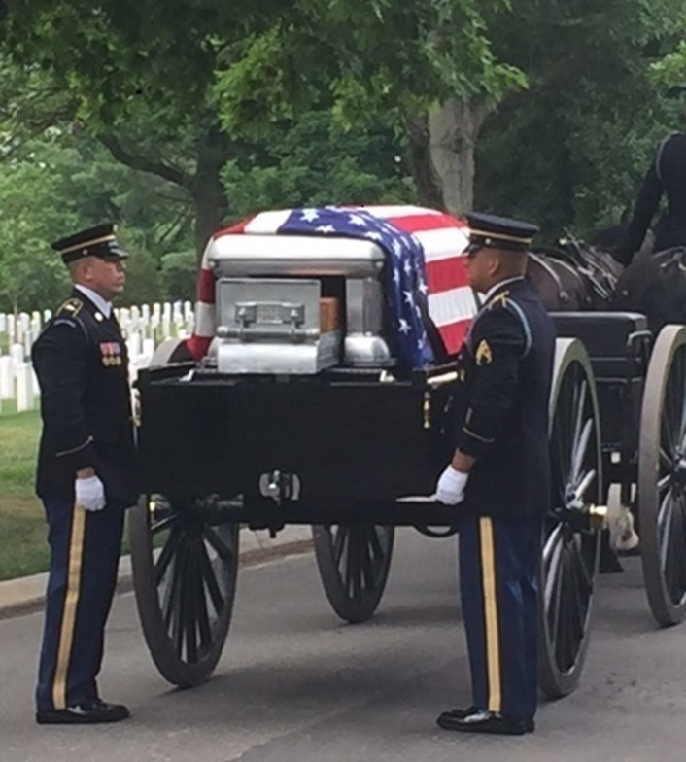
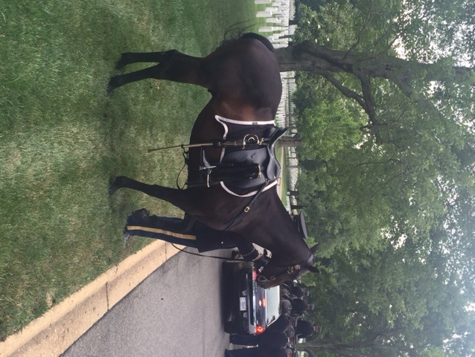
Alan J Magill Laid To Rest
Full military honors
Arlington National Cemetery
June 24, 2016
ASTMH represented in full force

Slide 19

Launch of the Alan Magill Fellowship and Forums in partnership with the
Magill Fellow:
Annual $50,000 award (for two years) supporting
mentorship and career development projects in
tropical medicine research, clinical care or
advocacy.
Only available to L/LMIC members
Call opened Nov 14, 2016
Made possible through a generous $2.5M gift from B&MGF

Slide 20
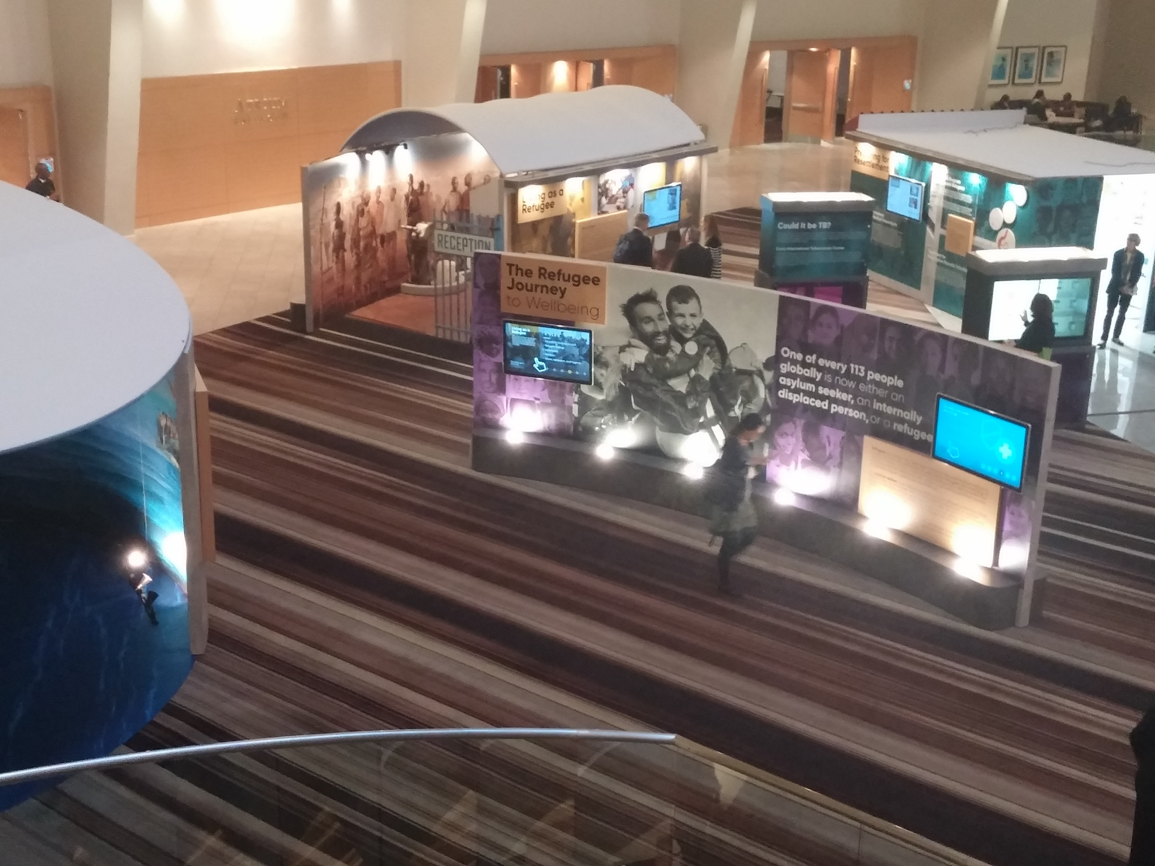
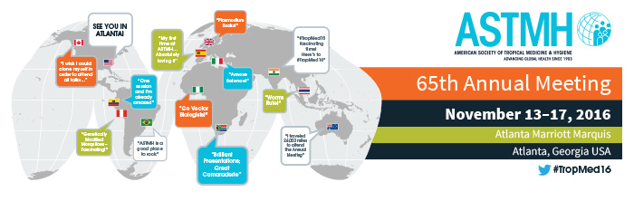
The Refugee Journey to Wellbeing
In Partnership with CDC Division of Global Migration
Marty Cetron, DGMQ, CDC

Slide 21
Media Q&A with Leading Zika Virus Experts
at TropMed Meeting in Atlanta
November 15th at 12 pm US Eastern Time (17:00 GMT)
World’s Leading Zika Experts to Hold High-Level Briefing as Mysteries Deepen
About Zika’s Health Risks and Future Spread—Particularly in the US
Scheduled speakers:
Stephen Higgs, PhD, President ASTMH
Anne Schuchat, MD, Principal Deputy Director for CDC
Peter Marks, MD, PhD, FDA
Ivan Gonzalez, MD, University of Miami Health System Pediatrics
Albert Icksang Ko, MD, Yale University School of Public Health
Pedro Fernando da Costa Vasconcelos, MD, PhD, National Reference Laboratory for Arboviruses, Brazil
Ann Powers, PhD, ASTMH Councilor, Chief, Alphavirus Laboratory, CDC
Moderator: Karen A. Goraleski, Executive Director, ASTMH

Slide 22
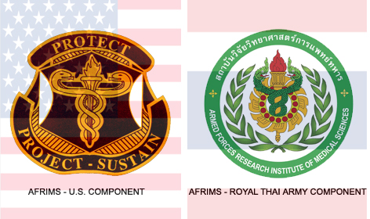

A Look Ahead … Bangkok, Thailand
Symposium: Thailand and ASTMH –
A Shared Vision in Tropical Medicine
December 7, 2016
Pat Walker: “Human Mobility and Health”
Chris Plowe: “The Science and Politics of Malaria Elimination in the Greater Mekong Subregion”
Karen Goraleski: “ASTMH: Leveraging the Voices of Scientists for Change”
December 8, 2016
Meeting with AFRIMS
Bangkok, Thailand

Slide 23

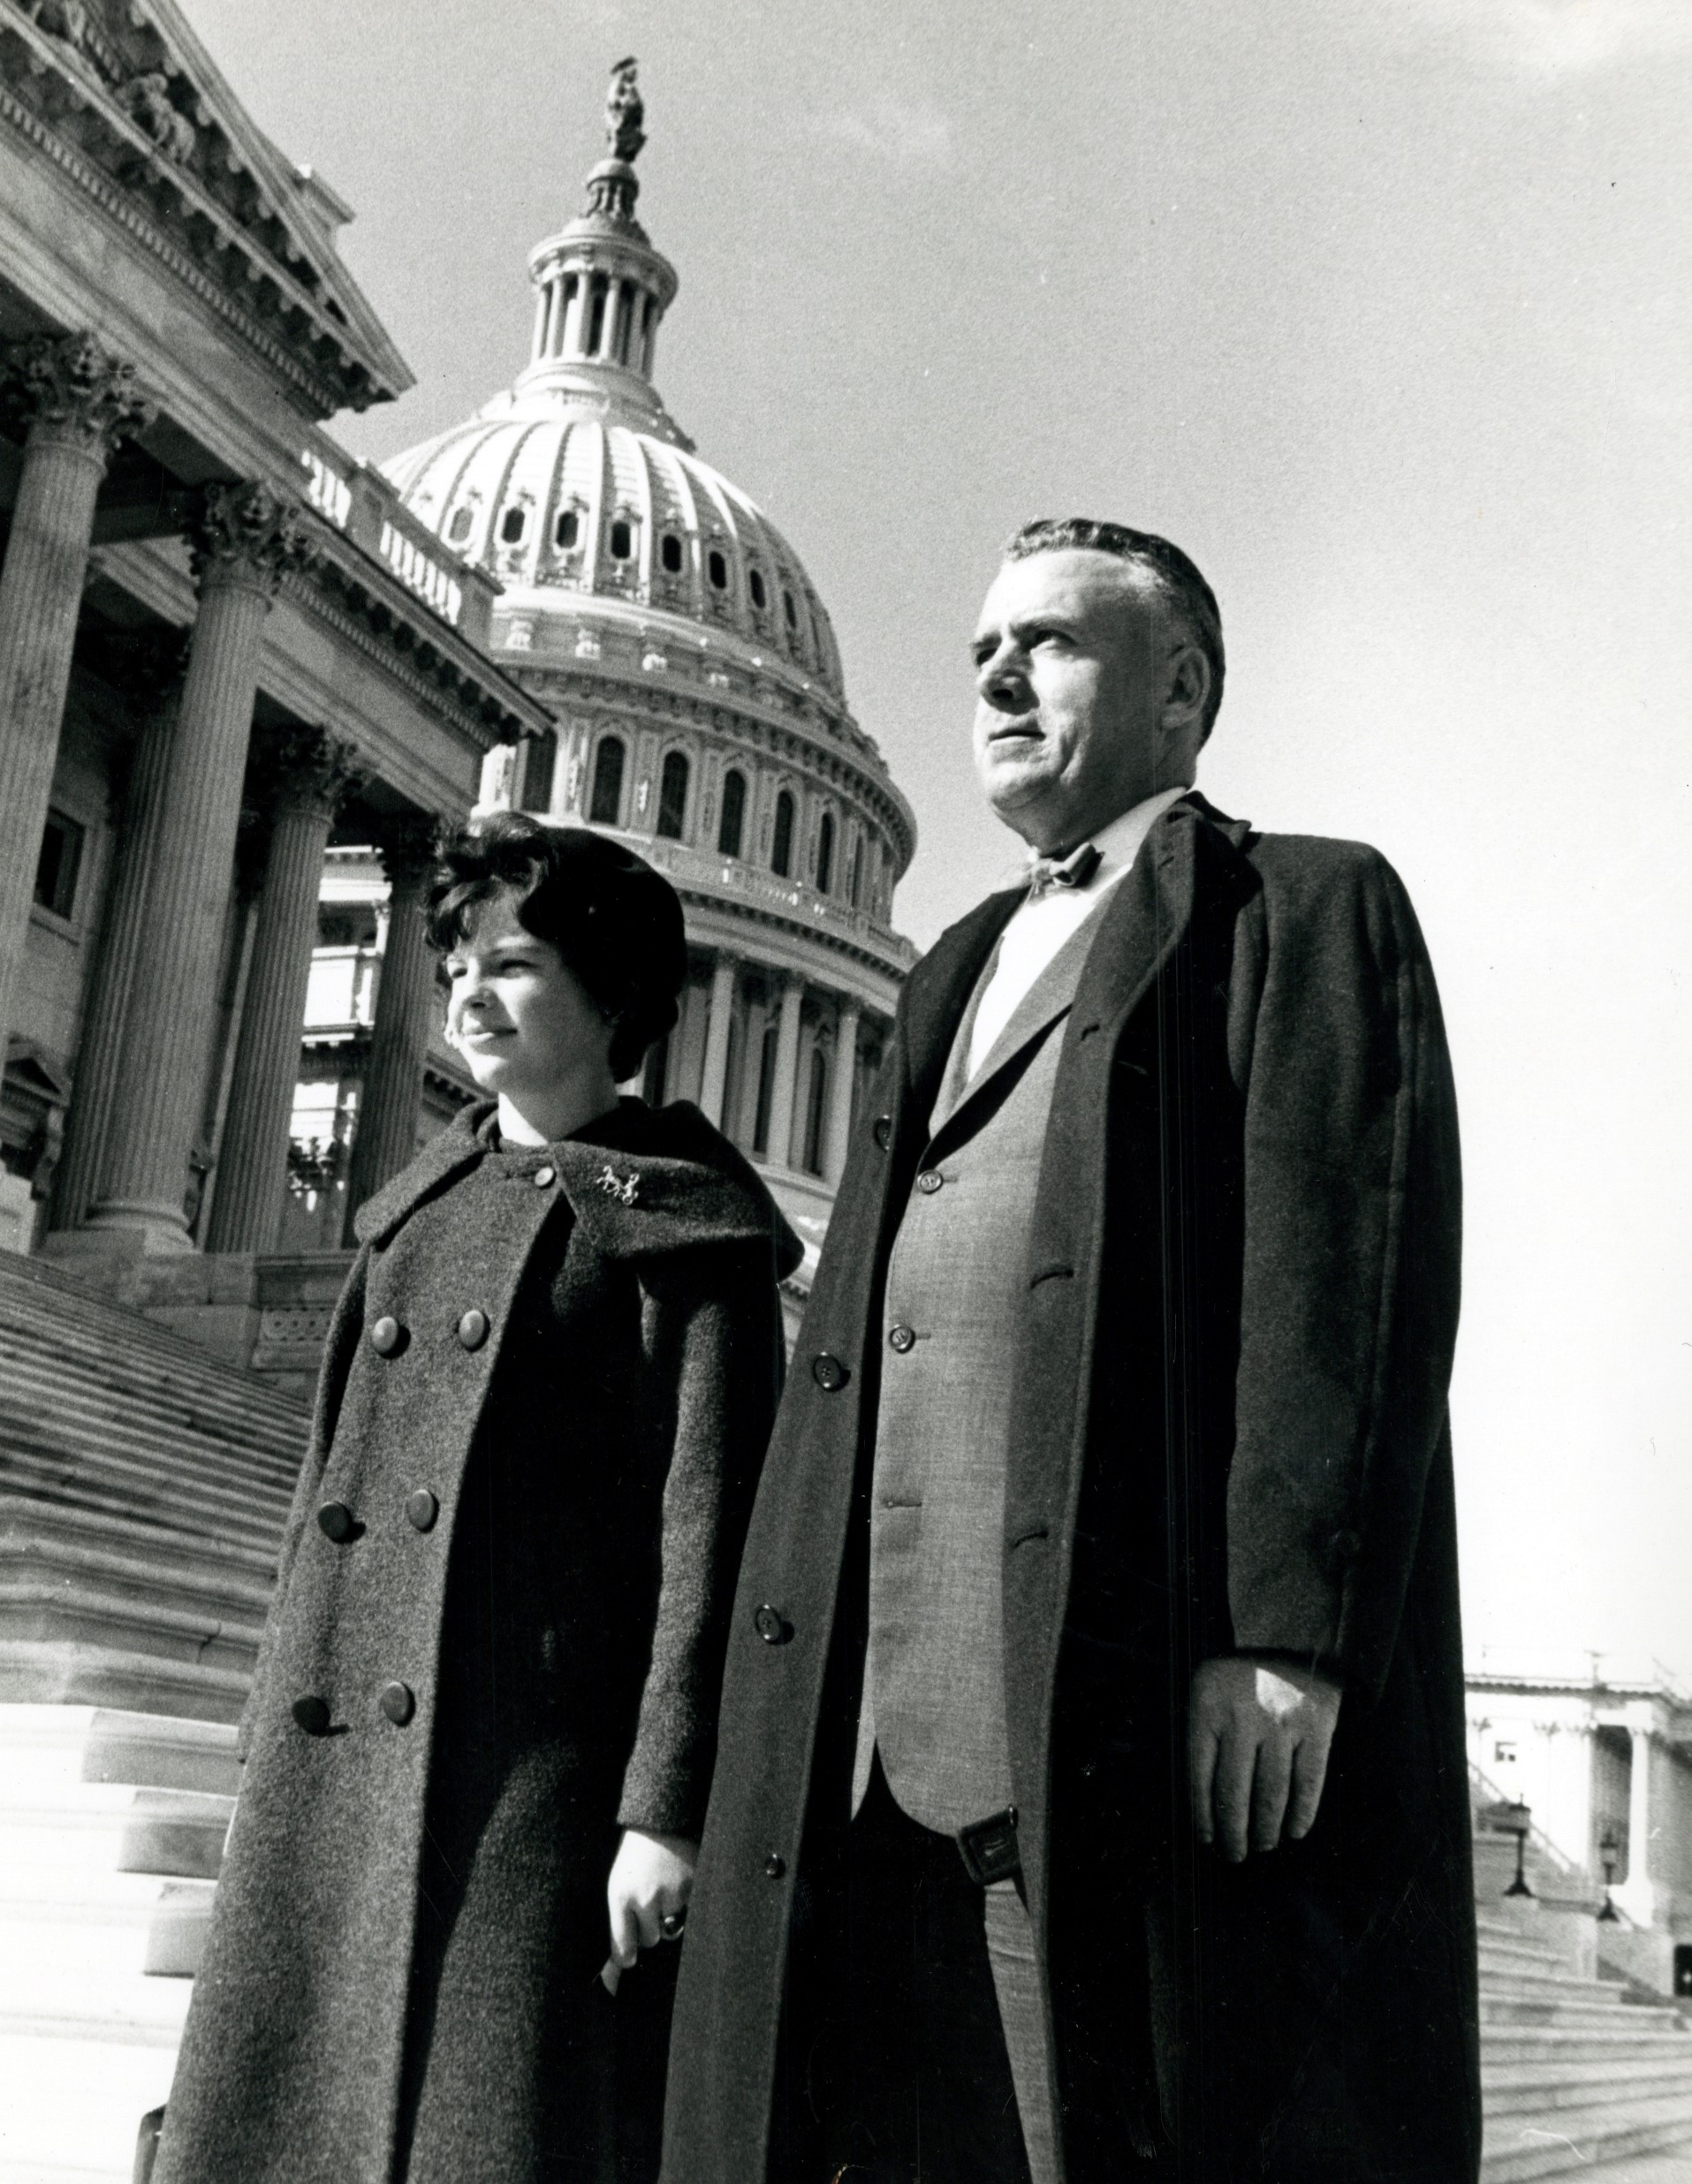
4 Invited Editorials
September 2017
1. “The Fogarty International Center is Essential to
Global Health Security,” John Edward Porter
2. “Let’s Eliminate Diseases, Not Institutes: The Case for the Fogarty International Center,” Philip Rosenthal, Karen Goraleski, Regina Rabinovich, Patricia Walker
3. “Congressman John E. Fogarty: A Champion for Global Health,” Mary Fogarty McAndrew
4. “Advocating for the Fogarty International Center: An Unsung Hero for Global Health Research and Development,” Jamie Bay Nishi, GHTC

Slide 24

ASTMH Partnership with WRAIR
2nd Annual Malaria Forum in tribute to the late Alan J. Magill (COL, Retired). This year's forum focused on malaria elimination and highlighted the themes of Discovery and Mentorship, two of Alan’s passions.
June 9, 2017
2 pm - Open House including posters
3 pm - Forum
-- Welcome and Opening Remarks: Lieutenant Colonel Norman Waters
-- Keynote Speaker: Dr. Pradip Rathod, University of Washington, Professor of
Chemistry and Adjunct Professor of Global Health; Director, NIH
International Center of Excellence for Malaria Research for South Asia
-- Speaker Series and Panel Discussion moderated by Regina Rabinovich
-- Closing Remarks: Lieutenant Colonel Norman Waters
5 – 7 pm - Reception

Slide 25
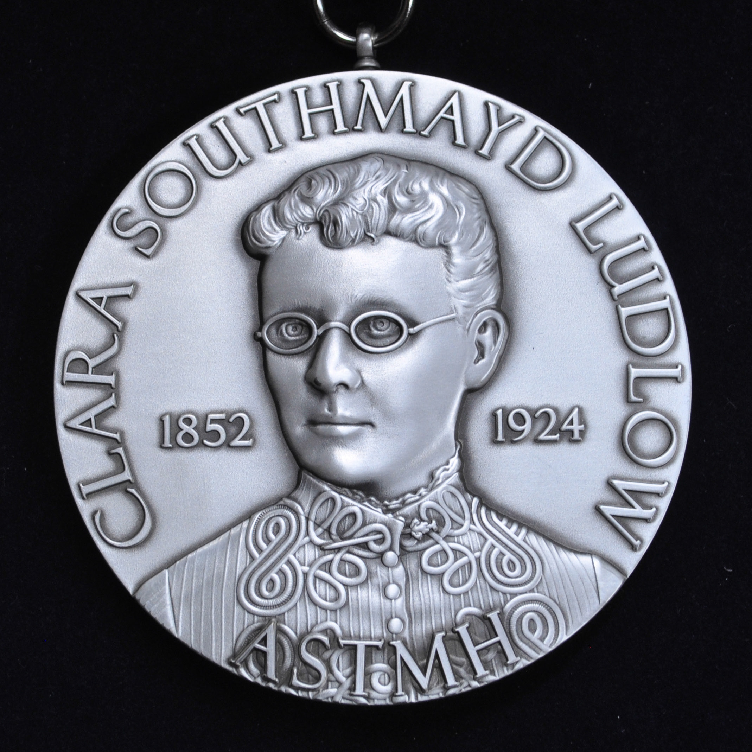

Clara Southmayd Ludlow Medal
First medal named after a woman leader in tropical medicine
First woman member of ASTMH; a PhD, entomologist
In recognition of her inspirational and
pioneering spirit in tropical medicine
Entomologist in Charge, Entomology Dept, Army Medical Museum

Slide 26

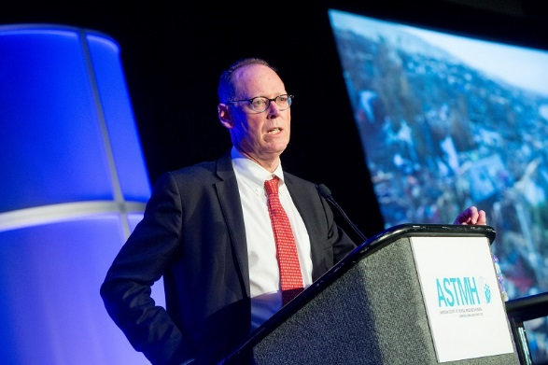
Annual Meeting Nov. 5-9, 2017 Baltimore
“If there was ever a professional society that embraced the equity agenda, embraced inclusiveness at scientific meetings, embraced trainees and students…I can’t think of any other society [than ASTMH]. It is an honor to be a member of this society.”
Paul Farmer, PhD, MD
Co-Founder and Chief Strategist, Partners In Health
Keynote, ASTMH Annual Meeting 2017

Slide 27
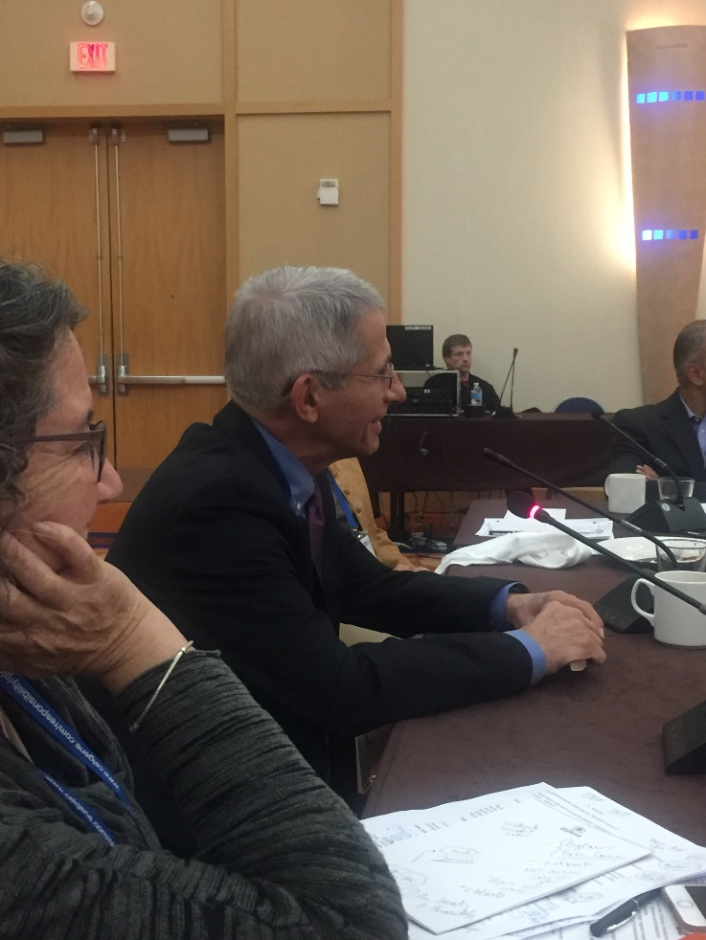
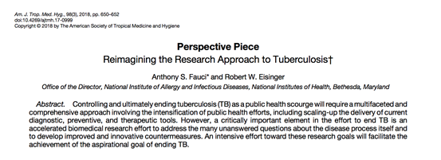
Council Meeting, November 9, 2017 Baltimore

Slide 28

White House Releases Budget Plan: ASTMH Responds (February 15, 2018)
“The 2019 U.S. Budget Process: A Threat to America’s Capacity to Respond to Microbial Threats and Assure Public Health and Safety”
“Just as we invest in a strong military to protect our country from armed threats, we also need a strong research and global health infrastructure to guard us from the threats of the microbial world. ASTMH understands that protecting ourselves from infectious diseases, investing in innovation and advancing U.S. scientific leadership can be done without sacrificing jobs, lives and global health security.”

Slide 29


AJTMH Supplements
September 2018
June 2018

Slide 30
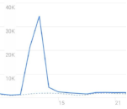
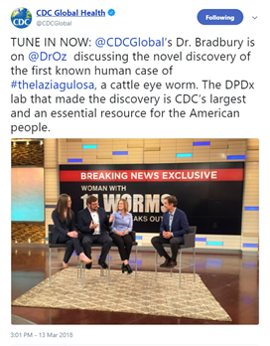
'Eye Worm' Study Results in Very High Traffic
to AJTMH Website, Media Coverage
Oregon woman's infection by Thelazia gulosa, resulting in significant news coverage
4,500+ tweets (and counting) drove unusually high number of users to Journal website
  96,397 total number of Journal website users in February, compared with 36,570 in January
NPR “Goats and Soda” wrote a Dr Seuss-like poem about the worm story
March 7 – Dr Oz show
Feb 12, 2017 Press Release

Slide 31
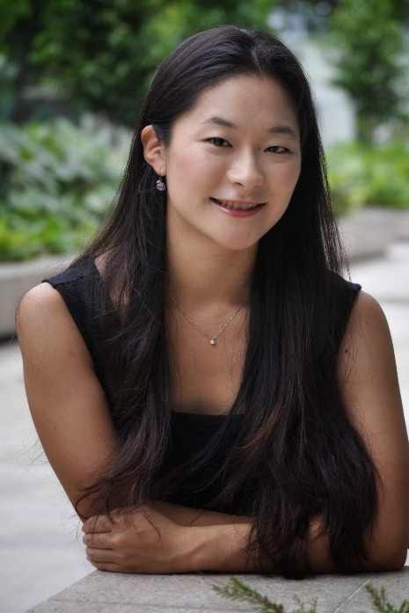

Members Make a Historic Governance Decision
Two Councilor seats added to be filled by
Student, Trainee, Resident, Post-Doc
ASTMH leadership recognized the value and importance of having early career voices in this high-level leadership role that focuses on strategy and fiduciary responsibilities.
Serving on the Council provides the opportunity to help ASTMH navigate and address some of the toughest issues facing tropical medicine/global health today including training, funding, and policy.
Anna Uehara
Koya Allen

Slide 32


ASTMH Inclusion/Respect Policy
“ASTMH is committed to an open and diverse environment that is built on dignity and mutual respect for all members, participants, and staff, free of discrimination.”
Adopted unanimously by the Board on October 27, 2018

Slide 33





Meet the 2019 Kean Fellows!
”I feel I am a part of the community of professionals committed to building systems of global health and equity.”
“I wanted to offer my sincere thanks to the ASTMH for making this entire project come alive. Without the ASTMH's support, I probably would not have been able to pull any of this off.”
“The Kean Fellowship has allowed me to take the lead on a project and gain experience working on a research question from formulation to conclusion.”

Slide 34

ASTMH Joins FDA Network of Experts (Sept 2019)
FDA staff has rapid access to knowledgeable ASTMH members with scientific or medical expertise to supplement existing knowledge and expertise within FDA
Primary objective: “permit FDA rapid access to various scientific viewpoints from individual experts…. because doing so will further the Parties’ mutual goals of having more innovative, safe, and effective diagnostic, preventive and treatment medical products on the market.”

Slide 35

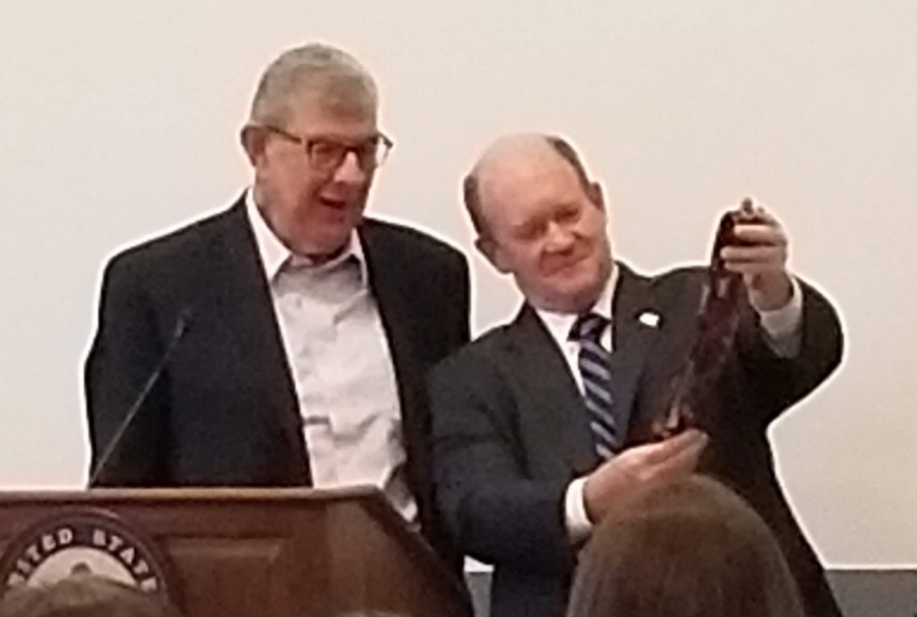

Working With Our Partners
4th Annual Magill Malaria Forum: Overcoming Challenges at the Front Lines of Malaria - April 26, 2019
Capitol Hill Briefing: The Department of Defense and the Fight against Malaria – In Conjunction with the Senate Malaria and NTD Caucus - September 24, 2019

Slide 36

Working With Our Partners

Slide 37
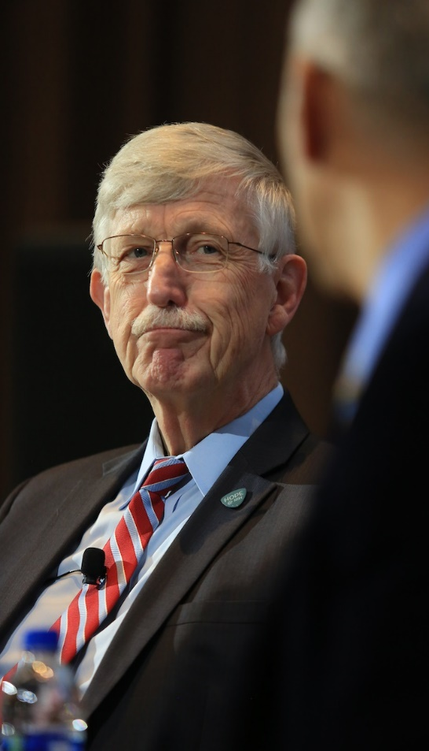
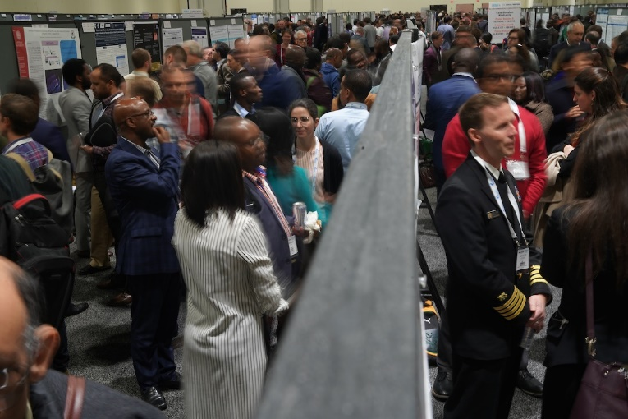
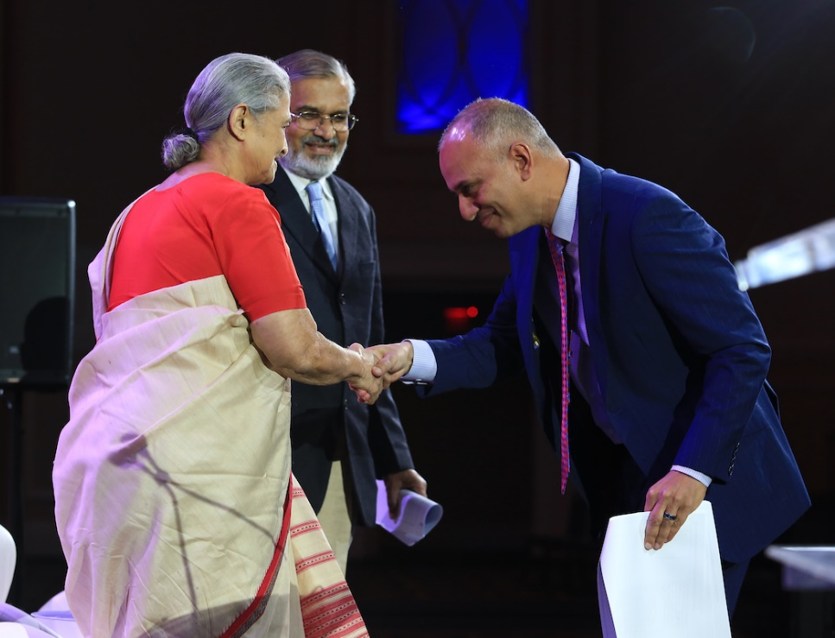
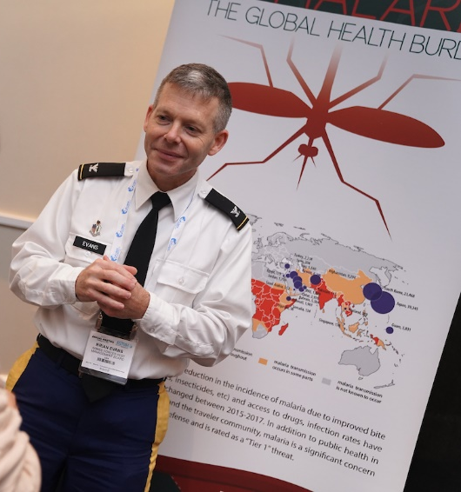
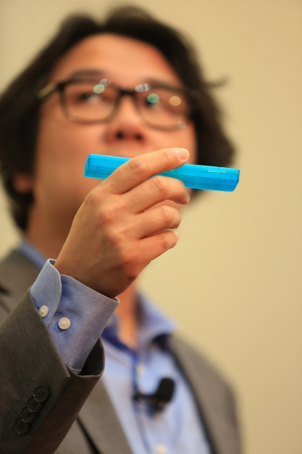
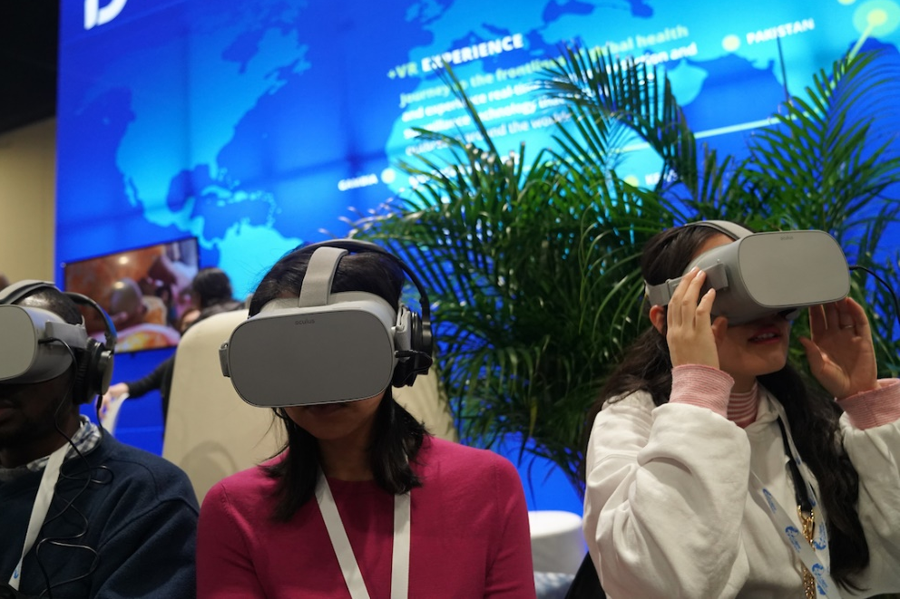
Annual Meeting 2019

Slide 38
ASTMH Condemns Racism
The role of structural racism as a determinant of health informs our views.
  “As President and on behalf of the ASTMH Board, our statement of inclusivity and respect is a stance of solidarity to ensure that all members and persons where we live and work are treated with respect, dignity and inclusiveness…”
– Joel G. Breman, MD, DTPH, FIDSA, FASTMH
June 4, 2020
Inclusion/Respect Taskforce
Co-Chairs: Julie Jacobson and Jonathan Stiles
Member survey sent in September, topline results to Board

Slide 39

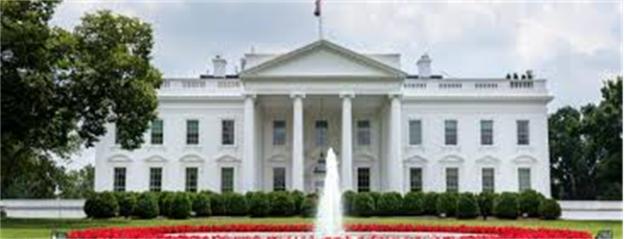



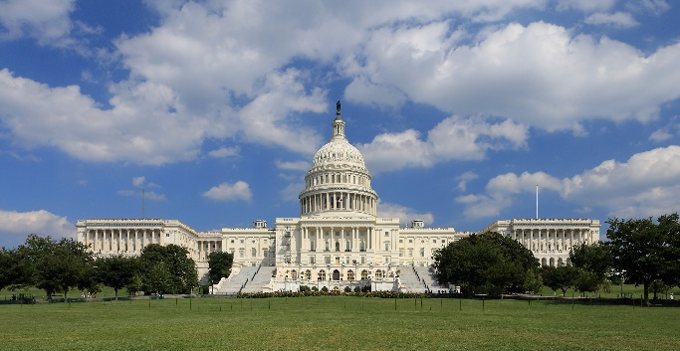


ASTMH’s Strong Voice on Behalf of Science
Since Jan 1, 2020 - 56 letters/statements with others and/or driven by ASTMH

Slide 40
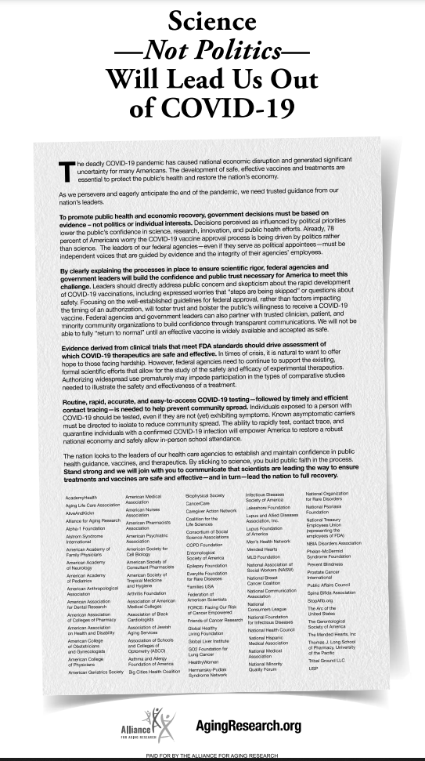

“Science – Not Politics – Will Lead Us Out of COVID-19”
ASTMH one of 79 organizations/societies
Wall Street Journal
Sept 26, 2020
Washington, DC print edition

Slide 41

GOTropMEd Launched Oct 20, 2010
NEW - ASTMH Global Online Tropical Medical Education resource
Heavy lifting by Digital Education Committee, Burness, Miranda Rogliano, Doug Dusik
97 resources; open access now; Jan 1 member only benefit

Slide 42


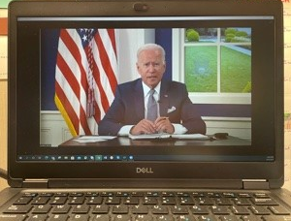
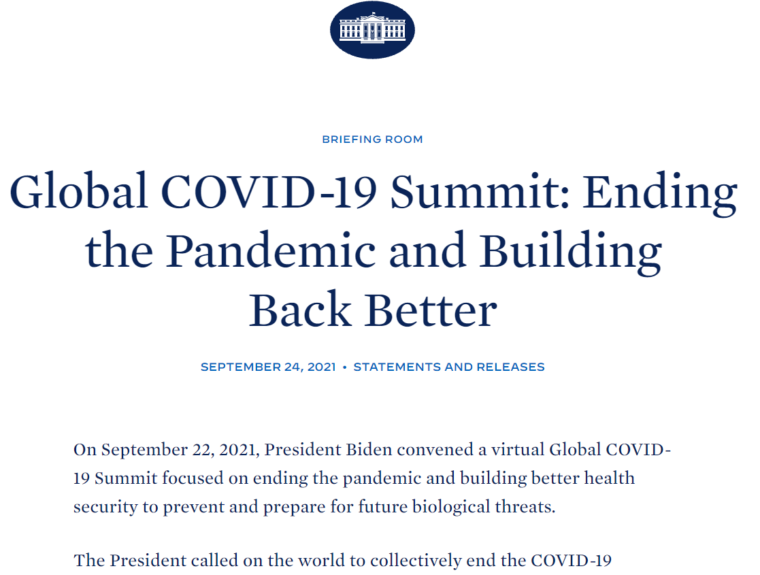
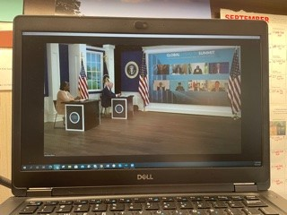
Invited to attend Virtual White House Global COVID-19 Summit: Ending the Pandemic and Building Back Better

Slide 43




ASTMH Applauds WHO’s Recommendation for Use of First Approved RTS,S Malaria Vaccine for Children
"This is the most exciting malaria news in years," said 2019 President Chandy John, MD, Director of the Ryan White Center for Pediatric Infectious Diseases and Global Health at Indiana University School of Medicine. "This vaccine could be a game changer when it comes to saving tens of thousands of young lives that are cut short each year by malaria.”
We are especially grateful to ASTMH member and vaccine development expert “Rip” Ballou, MD, who played an instrumental role serving as the scientific and programmatic leader for the Army malaria vaccine program until his military retirement in 1999, and later in his role leading vaccine development and discovery at GSK.

Slide 44


Slide 45
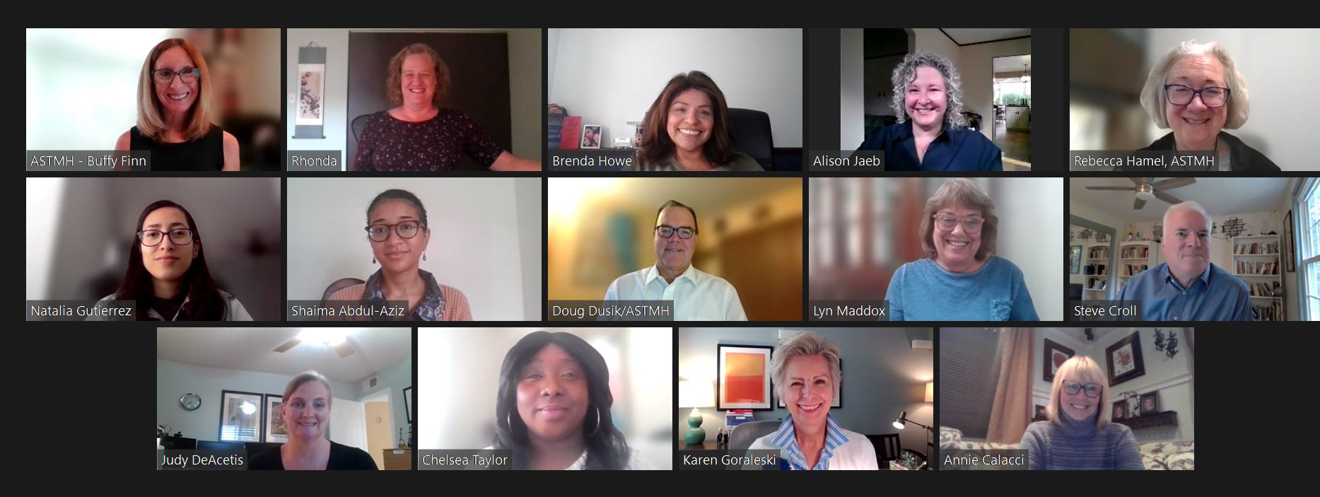

It Started with the Team and Ends with the Team
It’s been an honor and a privilege for me to do this work with you, and for you.

